Slide 1
Information Visualization Project Proposal and Dataset
G8-A
70969 – Mário Reis
75456 – Artur Fonseca
76046 – André Pires

Slide 2
INITIAL DATASET
01

Slide 3
Initial Dataset
Description
Our initial dataset was one file for each year (2007-2015) about unemployment from all the higher education courses registered in “Centro de Desemprego” and other file with entry grades of 2016 for all the higher education courses
The files from 2007–2015 each one had different layouts and different tables in short they were a bit heterogeneous as seen in the following samples

Slide 4
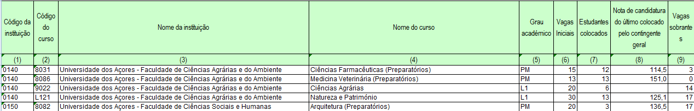
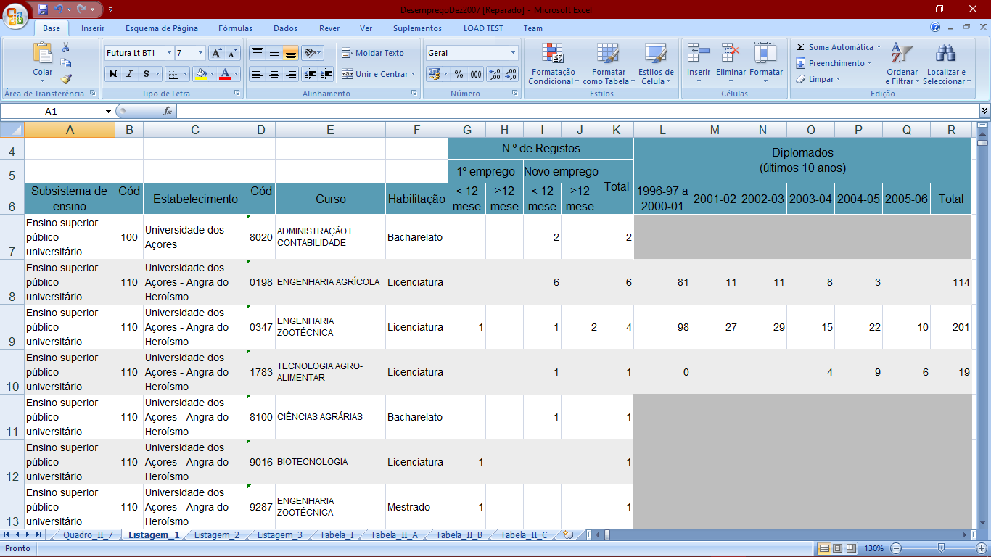
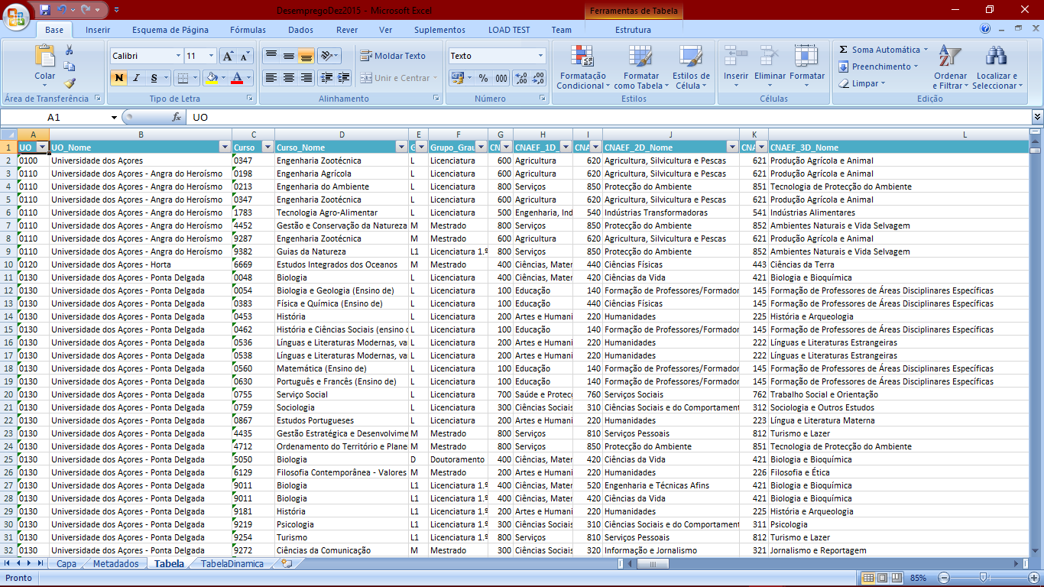
Initial Dataset
Data sample
(EntryGrades2016.xls)
(Courses2007.xls)
(Courses2015.xls)
Notes:
Note: This file is truncated because it has more than 50 columns/attributes.

Slide 5
Selected / derived data
02

Slide 6
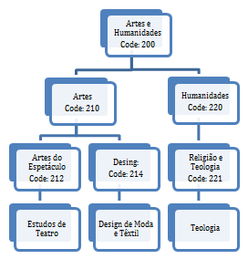
Selected data
Data description
We selected the following attributes: Year, Course Name, Course Code, University Name, University Code, Degree Level, Total Unemployed, Total Graduates, Course Area Code, Course Area Name and Entry Grade
A little explanation about course areas, there are 3 hierarchical levels but top level has many roots “it is a forest of trees”, the image at right summarize the idea (Leaves are the courses)

Slide 7
Derived data
Derived data description
We calculated the following derived measures for each year:
% Unemployment By Course for each year
(100 * Total Unemployed of Course/ Total Graduates of Course)
Task 1: Compare the unemployment (%) of different courses (regardless of course conclusion year of the graduates)
Task 2: Present the information about unemployment (%) from a specific course graduates across time

Slide 8
Derived data
% Unemployment by Each University for each year
(100 * Total Unemployed of University/ Total Graduates of University)
Task 3: Identify the university with more unemployment (%)
% Unemployment By Each Area Level for each year
(100 * Total Unemployed of Area/ Total Graduates of Area)
Task 5: Summarize the employment/unemployment by graduation areas

Slide 9
Data abstraction
03

Slide 10
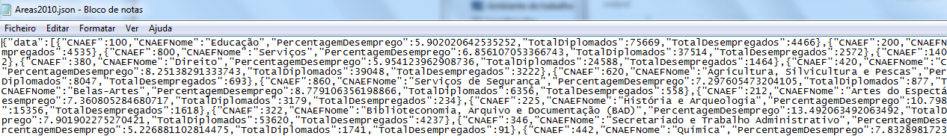
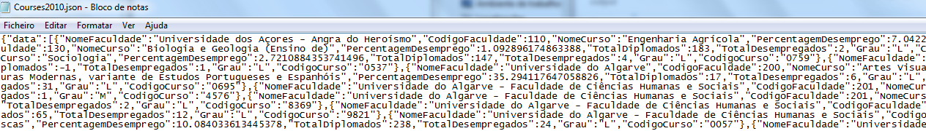
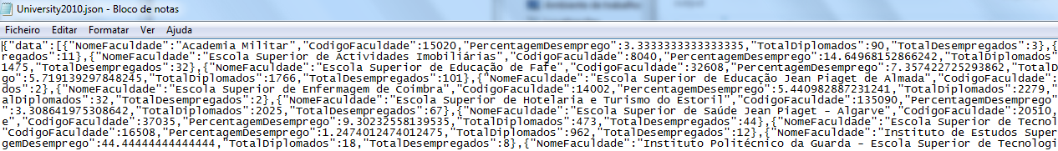
Data abstraction
Description:
Dataset type:
A Table

Slide 11
Data abstraction
Year - {Continuous|Sequential|Not Hierarchical}
It represents the year of the data statistic
Course Name/Course Code - {Nominal|Not Hierarchical}
Name of the course/Code of the course
University Name/University Code – {Nominal|Not Hierarchical} Name of the University/Code of the University
Degree Level – {Nominal|Not Hierarchical}
If the course is Bachelor’s, Masters...

Slide 12
Data abstraction
Total Unemployed by Course/Area Level/University – {Ratio|Sequential|Not Hierarchical}
Total number of unemployed of the course/all the unemployed from that area/all the unemployed from a university
Total Graduates by Course/Area Level/University – {Ratio|Sequential|Not Hierarchical}
Total number of people that concluded course/all the graduates from courses of the area/all the graduates from courses of the university

Slide 13
Data abstraction
% Unemployment by Course/Area Level/University – {Ratio|Sequential|Not Hierarchical}
It represents the percentage of unemployed people by course/Area level and University
Course Area Name/Course Area Code – {Nominal|Hierarchical}
It represents the code of the course area
Entry Grade – {Ratio|Sequential|Not Hierarchical} Entry grade for the bachelors course

Slide 14
Dataset processing
04

Slide 15
Dataset processing
Dataset cleaning description
We used the table from 2015 to obtain the courses-area relationship, because it was the only one with that information and crossed it with all the other tables to obtain all the information we need.

Slide 16
Dataset processing
Problems found:
Some courses didn’t have information about total graduates
We ignored these courses to make the calculations and aggregations and assigned -1 to the total graduate’s field and unemployment %.
Extinction of courses from “Bolonha”
We cleaned some records in 2007

Slide 17
Mapping
05

Slide 18
Mapping
Does Computer Science graduates in IST have more unemployment, in 2015, than Computer Science in ISEL? And in 2007? (Task 1)
What was the year which had less unemployed people from Computer Science in IST? (Task 2)
Data: Courses20XX.json (attributes: Course Name, University Name, % Unemployment by Course)

Slide 19
Mapping
What is the university with more unemployment? (Task 3)
Data: Universities20XX.json (attributes: University Name, % Unemployment by University)
Where the unemployment will be higher? In a course with 14 minimum entry grade or one with 17? (Task 4)
Data: EntryGrades2016.json (attributes: Grade, % Unemployment by Course)

Slide 20
Mapping
What is the graduation area with less/more unemployment? (Task 5)
Data: Areas20XX.json (attributes: Course Area Name, % Unemployment by Area)

Slide 21
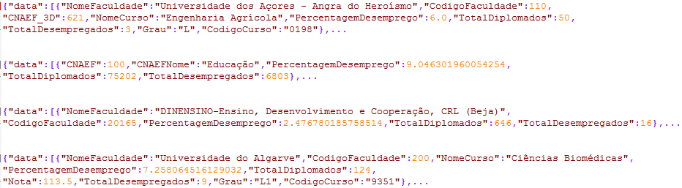
Mapping

